Slide 1
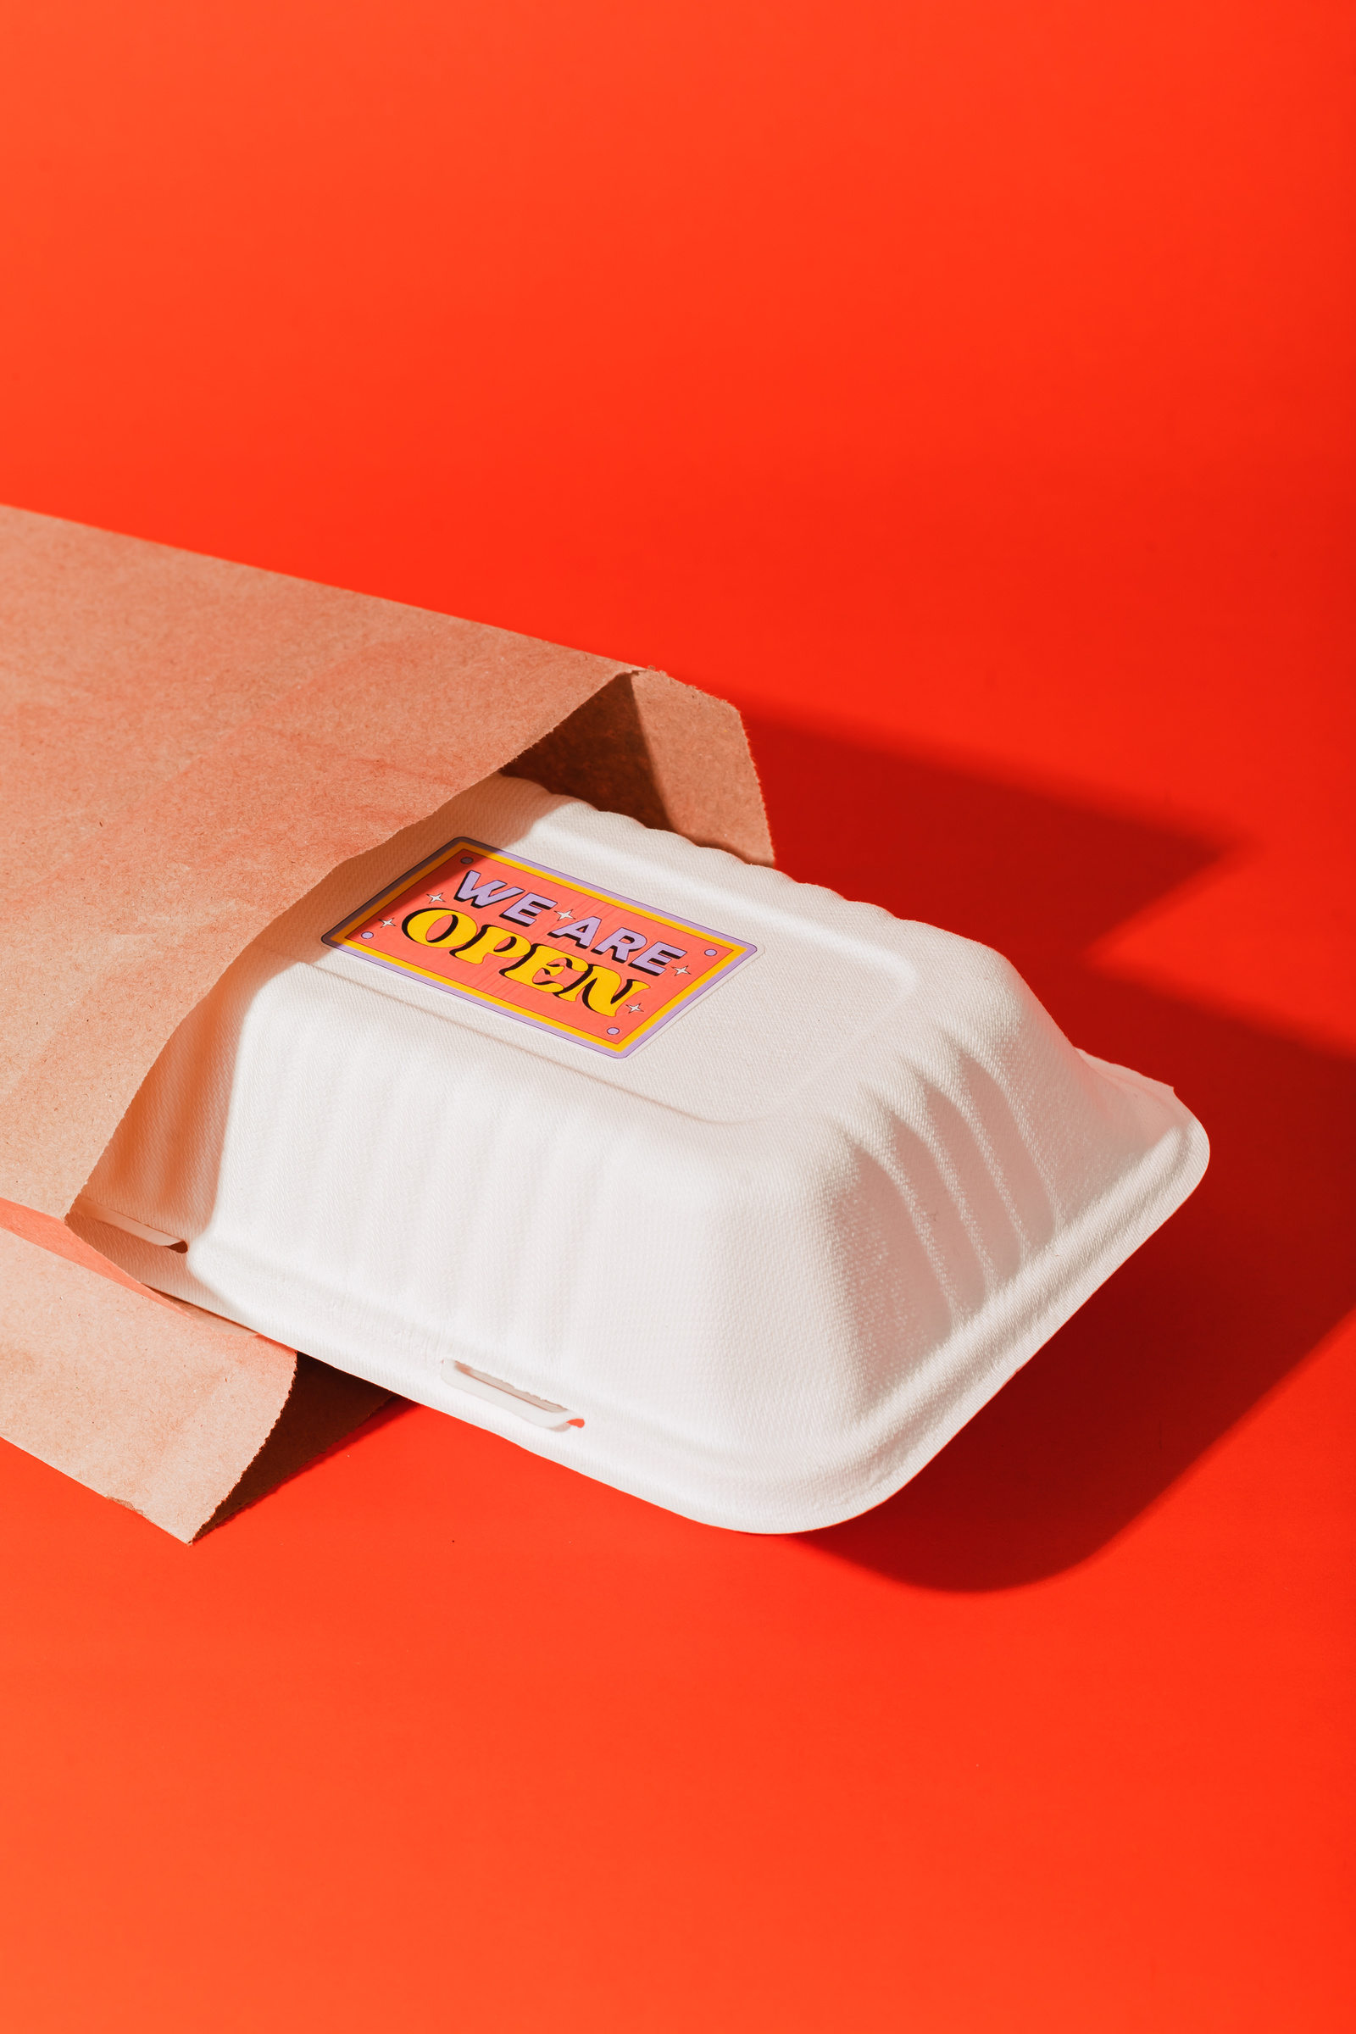


QuickBite
Home
About Us
Contact
QuickBite
Hello,
We Are Open!
AN
ONLINE FOOD ORDERING PLATFORM
THE BEST FOOD DELIVERY SERVICE IN TOWN!
01

Slide 2


QuickBite
Home
About Us
Contact
Outline
Introduction
Objective
Hardware and Software Requirements
System Architecture
Class Diagram of your System
Project Demonstration
Testing
Limitations
02

Slide 3


QuickBite
Home
About Us
Contact
Introduction
QuickBite is an online platform designed to simplify food ordering. Customers can browse menus, place orders, and make secure payments easily. It also offers restaurants flexible menu management and order customization to enhance the user experience.
03

Slide 4
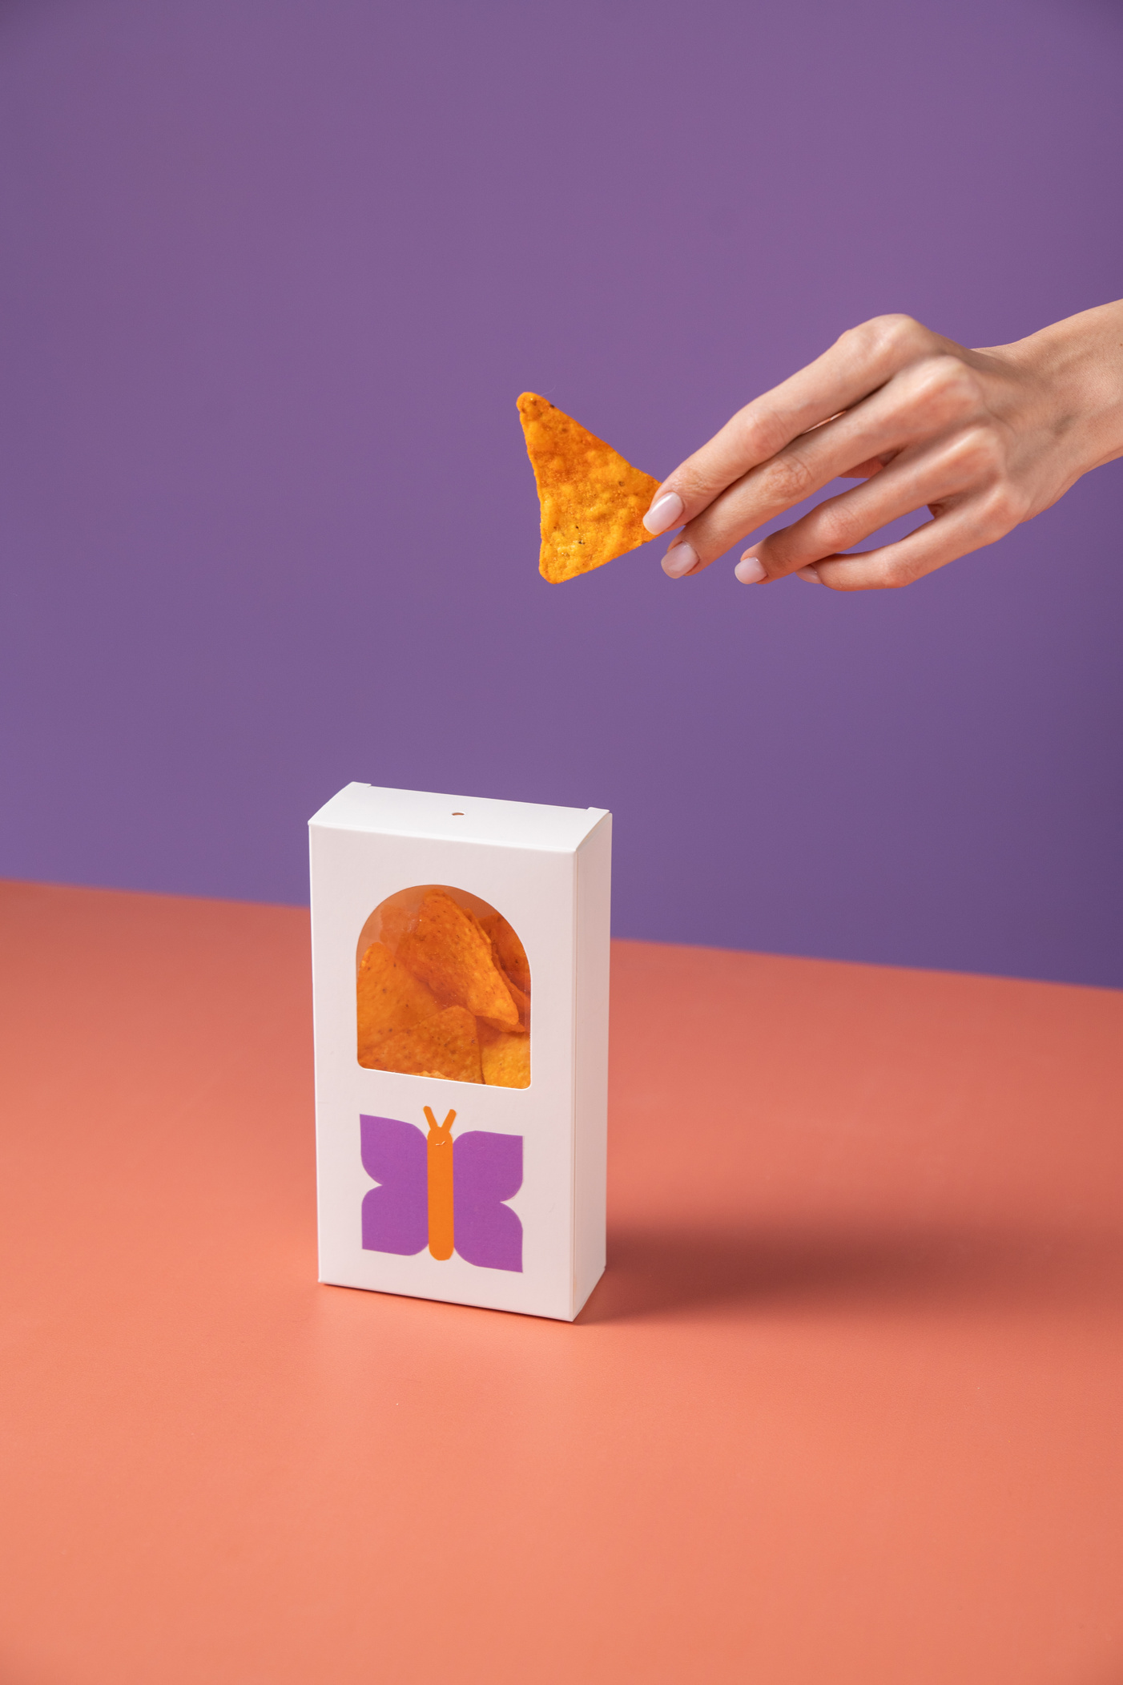
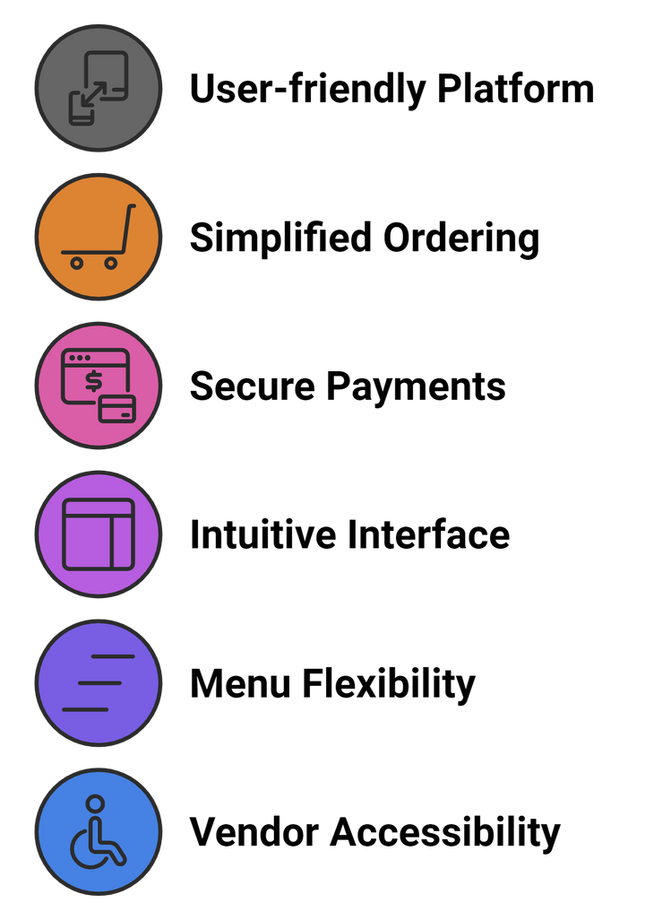
QuickBite
Home
About Us
Contact
Objective
04

Slide 5
QuickBite
Home
About Us
Contact
Aysha Jahan (2104010202302)
-User Authentication
Adnan Chowdhury (2104010202297)
-Product and Menu Management
Tamjidul Hasan (2104010202285)
-Order and Cart Management
Rohed Deb Ove (2104010202296)
-Order and Cart Management
Project
Organization
05

Slide 6
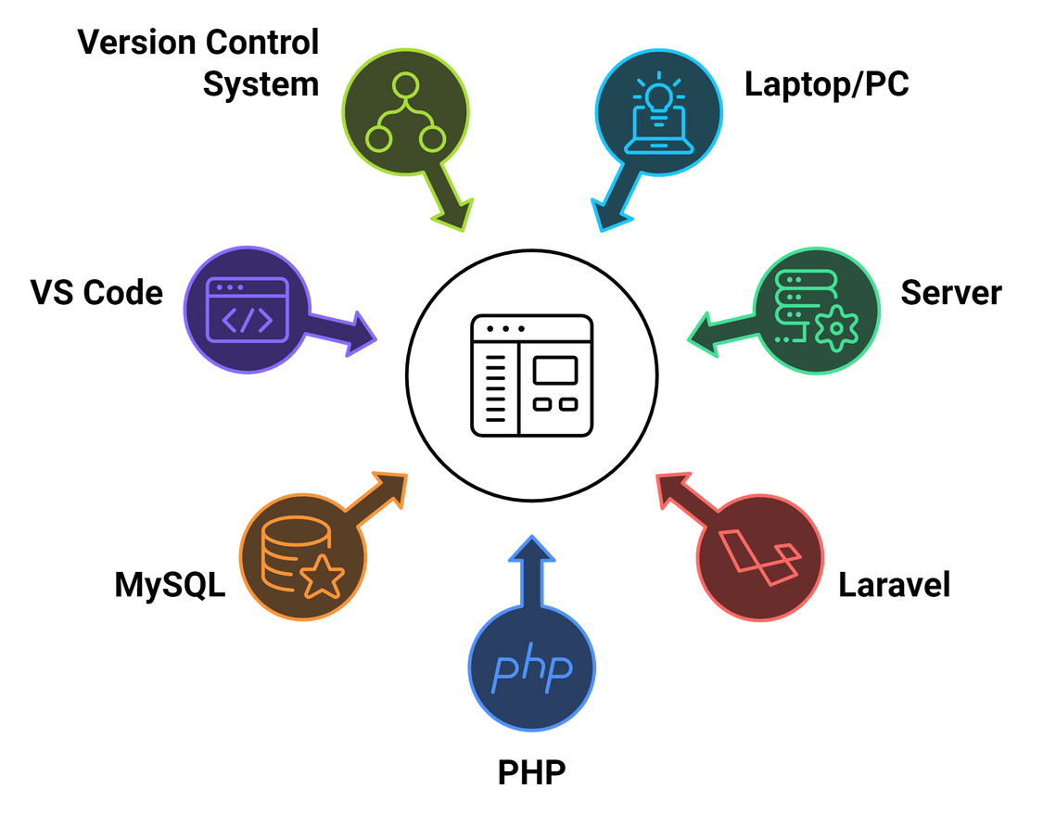

QuickBite
Home
About Us
Contact
Hardware & Software Requirments
06

Slide 7
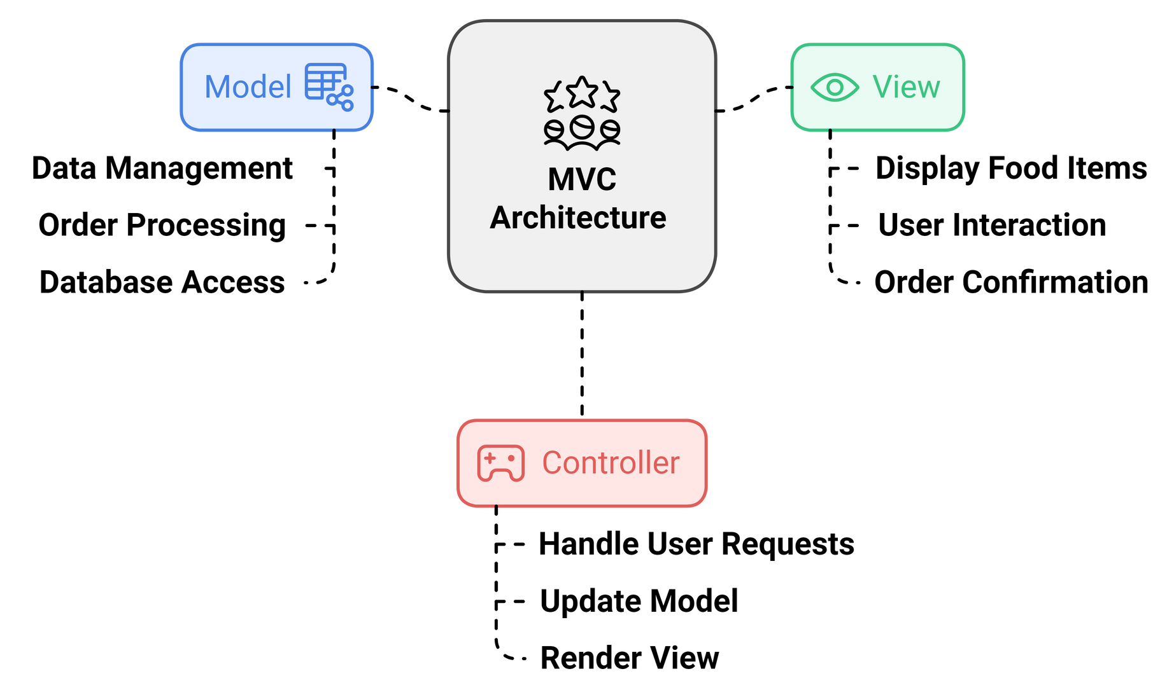
QuickBite
Home
About Us
Contact
System Architecture
07

Slide 8
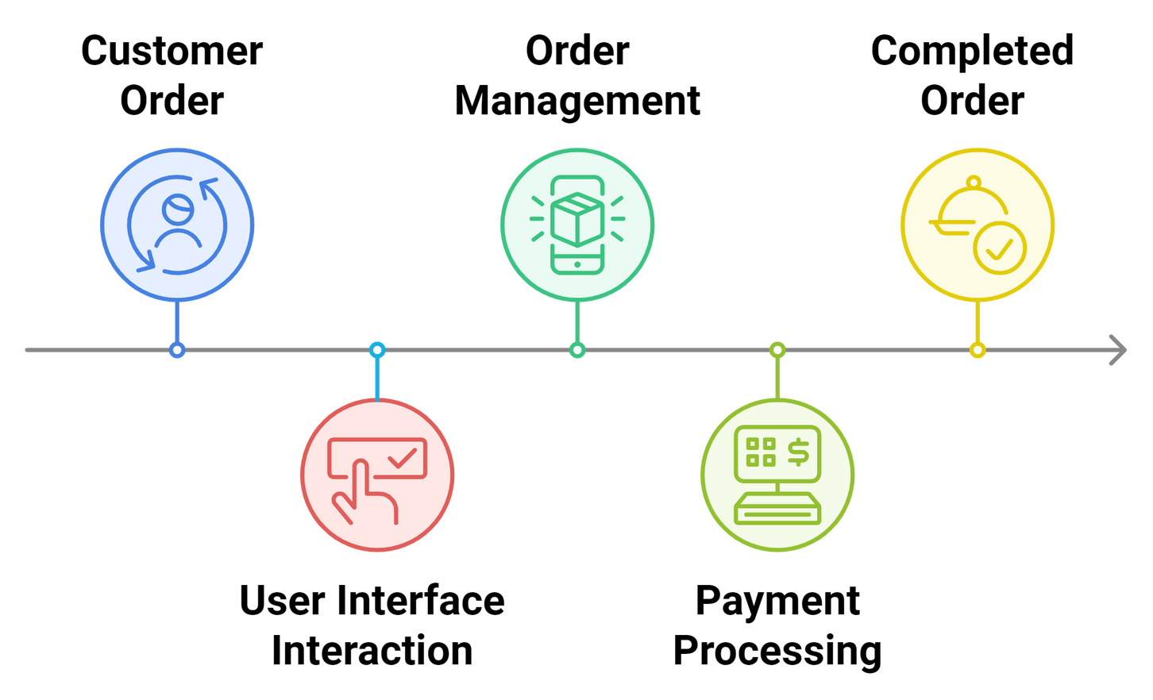


QuickBite
Home
About Us
Contact
System Feature
08

Slide 9
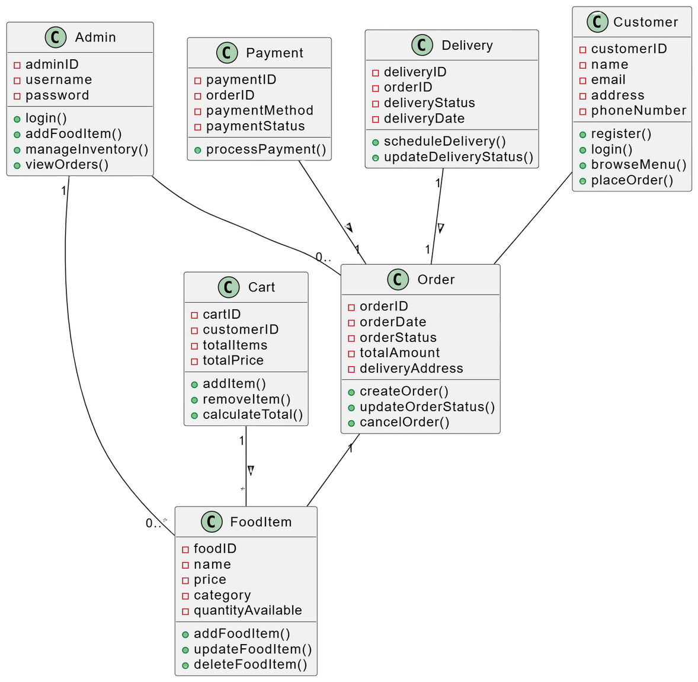
QuickBite
Home
About Us
Contact
Class Diagram
09

Slide 10
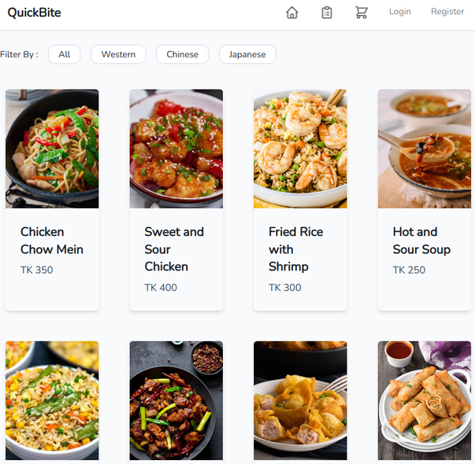
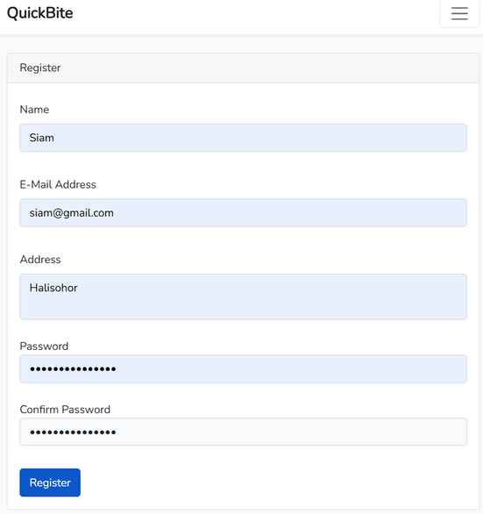
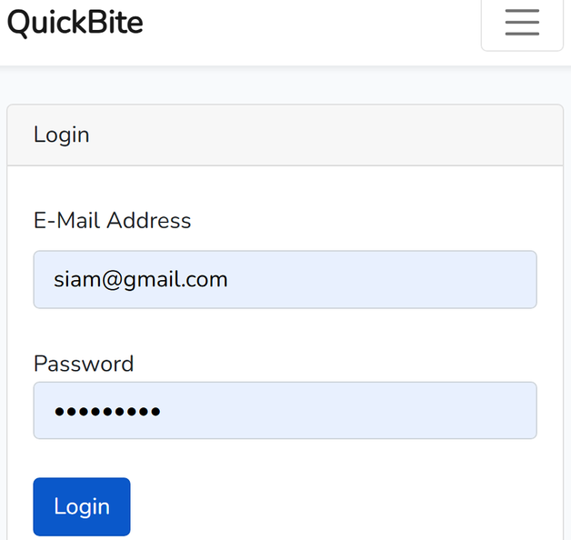
QuickBite
Home
About Us
Contact
Project Demonstration
Home Page
Registration
Login
10

Slide 11
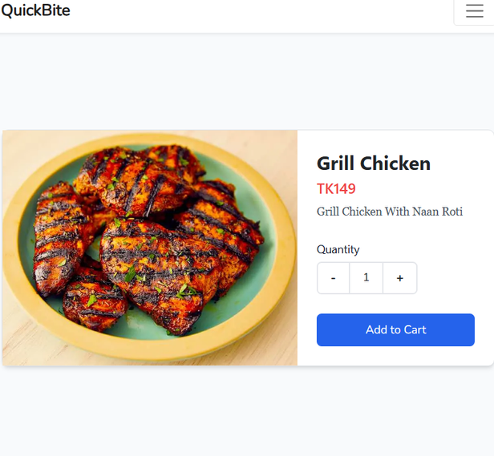
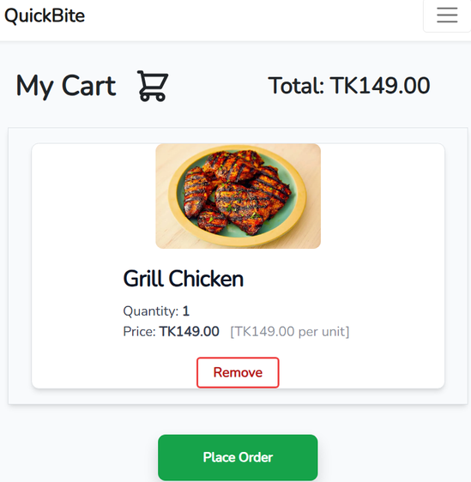
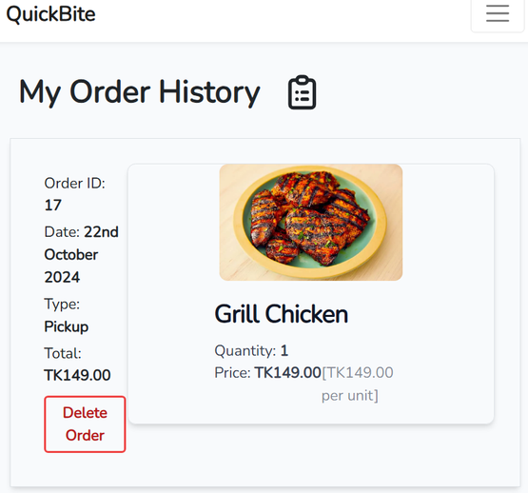
QuickBite
Home
About Us
Contact
Add to Cart
Cart View
Order History
11

Slide 12
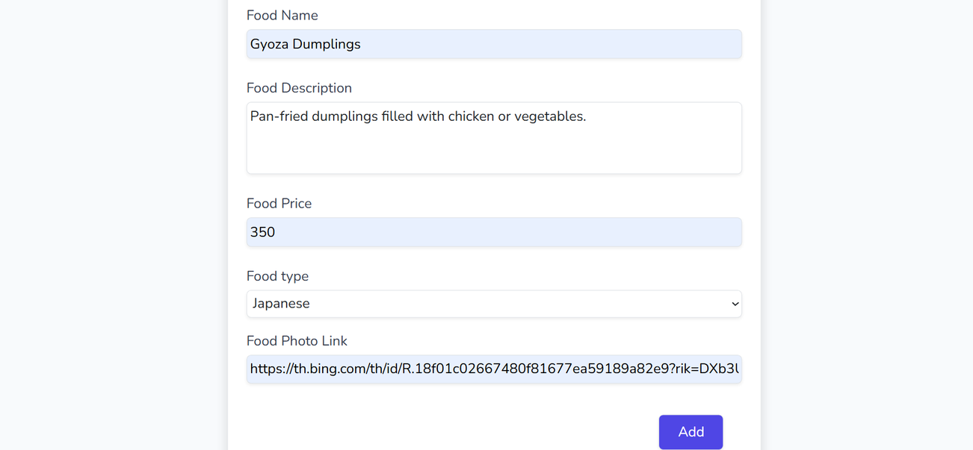
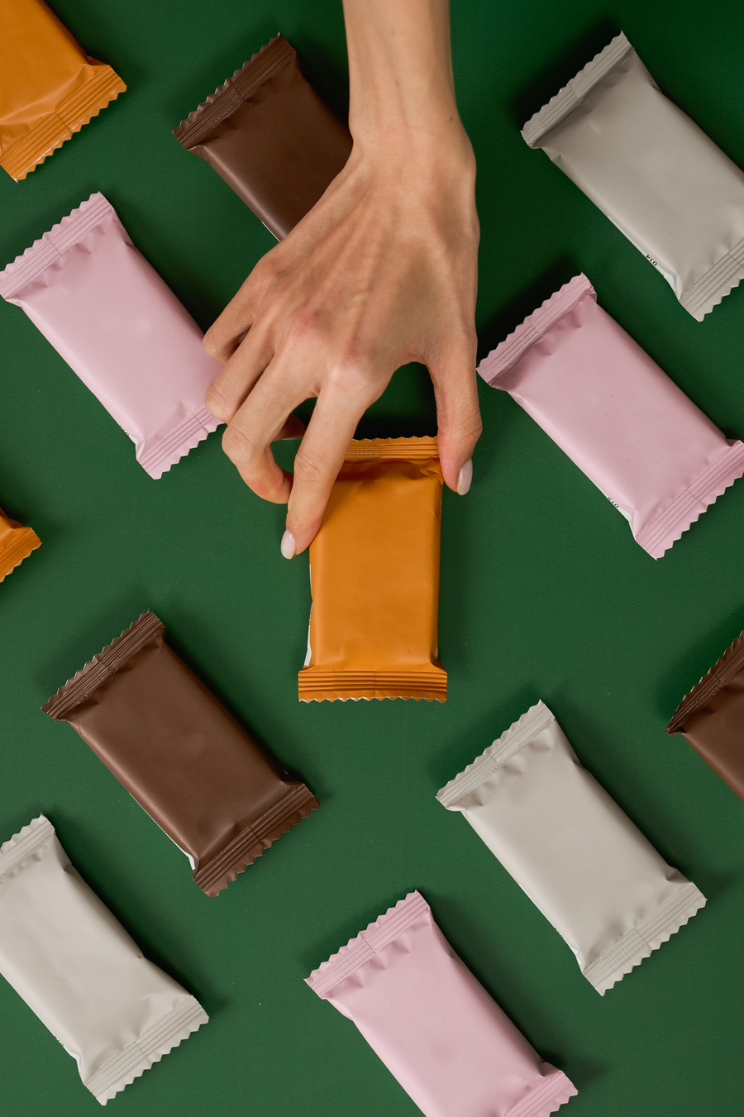
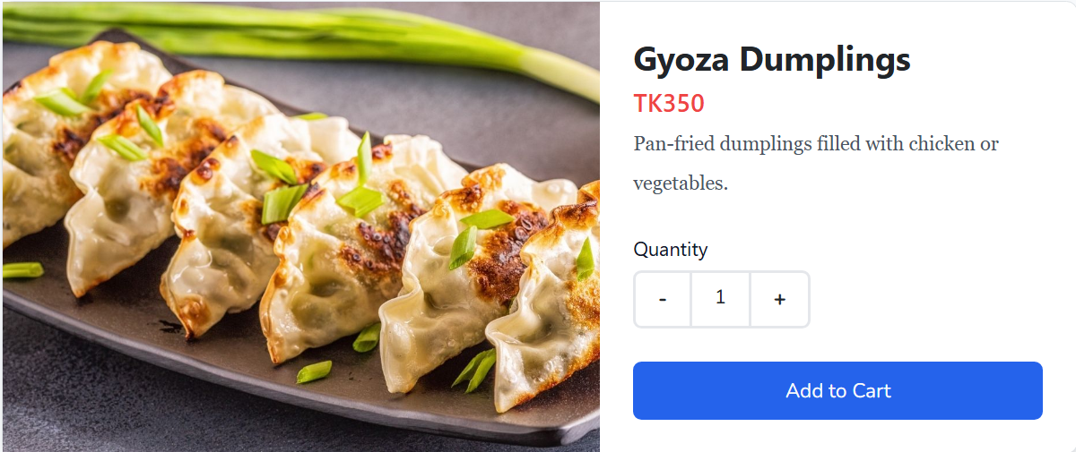
QuickBite
Home
About Us
Contact
Product Add
12

Slide 13
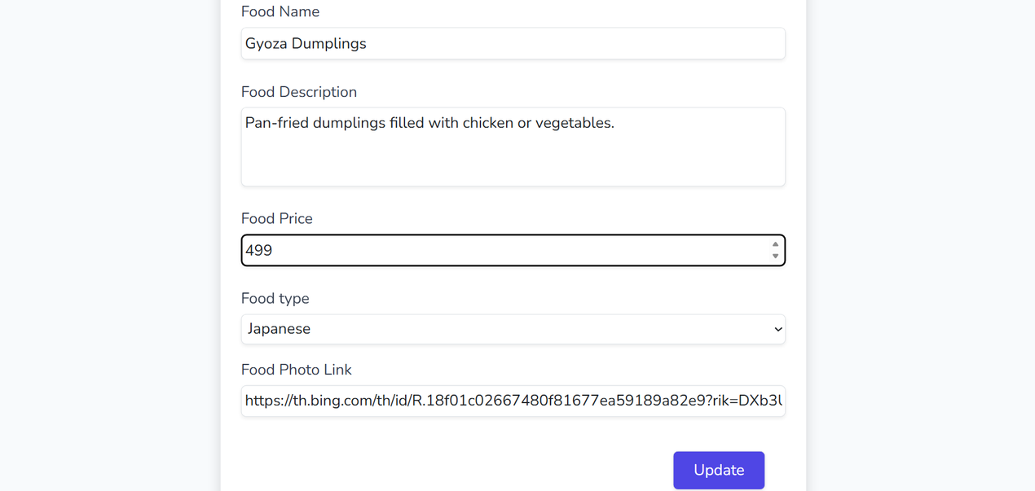

QuickBite
Home
About Us
Contact
Product Update
13

Slide 14
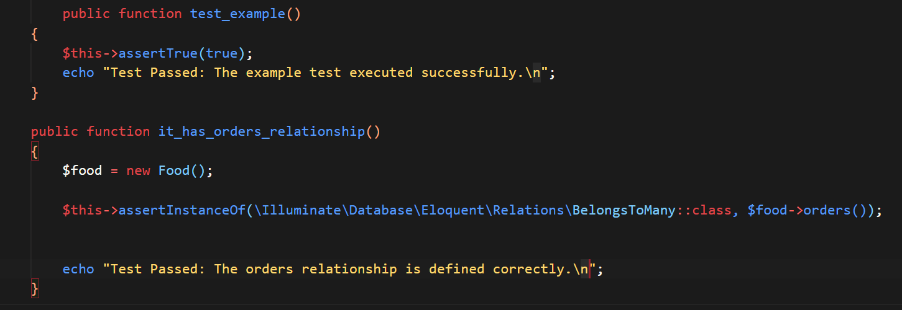
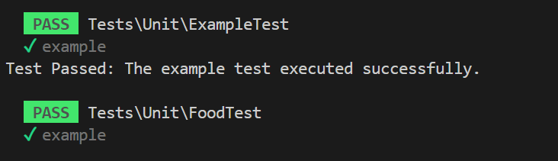
QuickBite
Home
About Us
Contact
Testing
Unit
Testing
14

Slide 15
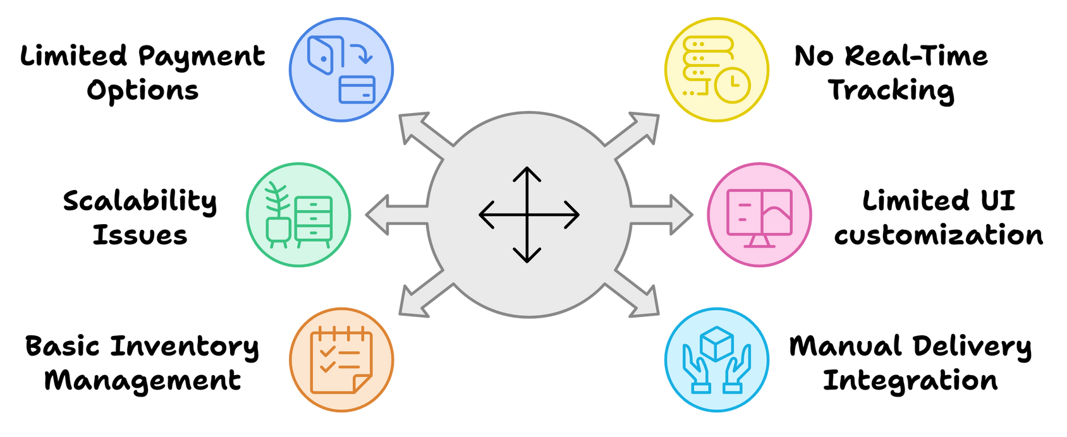
QuickBite
Home
About Us
Contact
Limitations
15

Slide 16
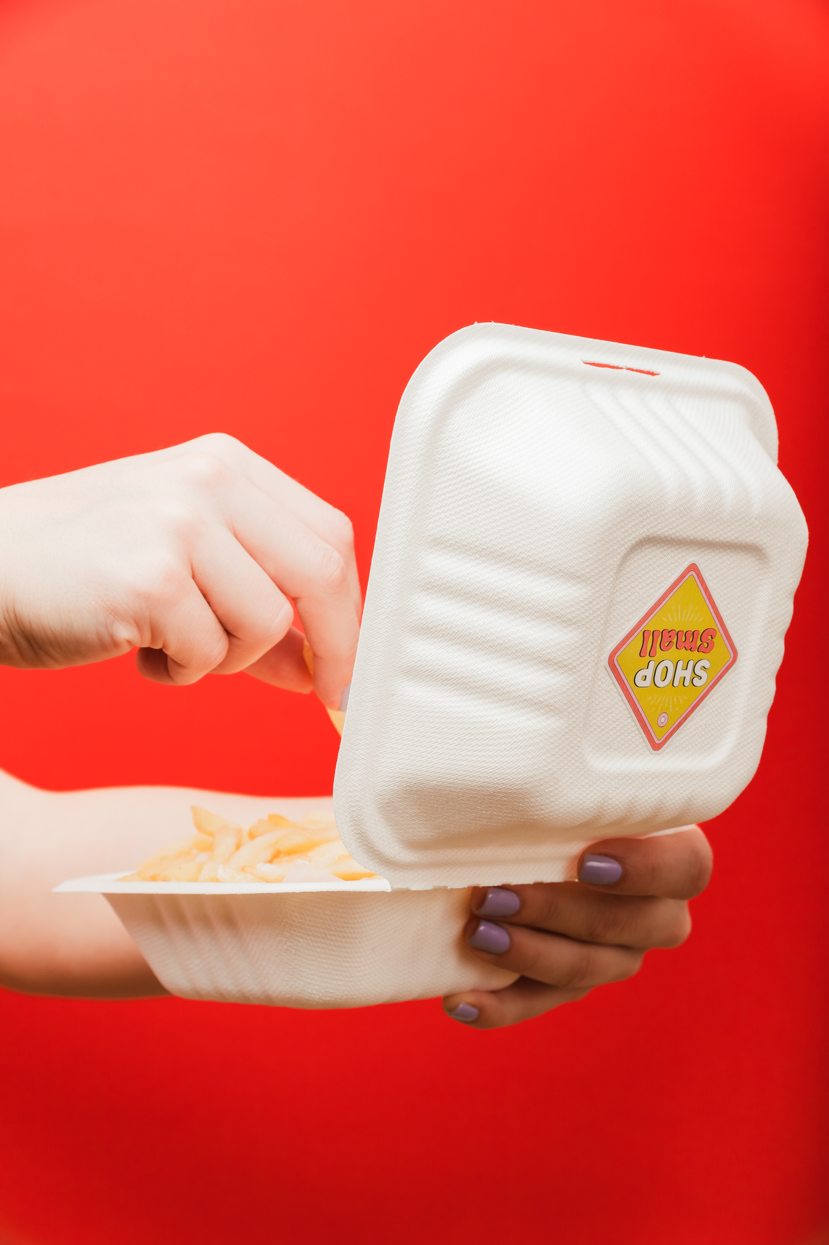

QuickBite
Home
About Us
Contact
Thank
You!
WWW.QUICKBITE.COM
16

